Slide 1
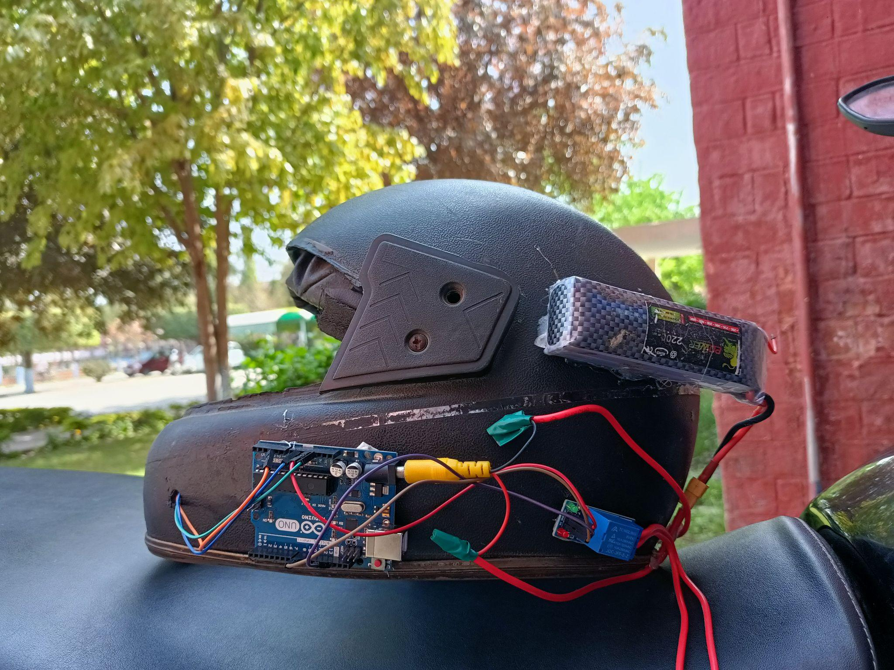
SMART HELMET
By THE INNOVATORS

Slide 2
Problem statement
Casualties due to two wheeler accidents.
4 people die every hour because they do not wear helmet.
And sometimes if they have helmet on they are drunk or they have some kind of intoxication.
2 people die every hour due to this.
In some cases the situation become severe because of increased response time ,family and friends are informed late

Slide 3
Solution and End cases
Prompting the driver to wear helmet for riding and starting the ignition. The helmet should be well fit otherwise ignition will stop.
– The spring loaded metallic/ conducting switch should be pressed appropriately against the helmet
MQ 3 is used to discourage anyone from driving after drinking. The sensor is activated only after the initial switch is pressed
– The sensor is capable of detecting alcohol concentration from 25 to 500 ppm, 400 is considered suspicious if found>400 arduino stops power supply.

Slide 4
Solution and End cases
3. In case of unforeseen circumstances such as accidents, the shock sensor will detect the vibrations and it will send data to thingspeak.com
Thingspeak service would trigger a URL, which would in turn would trigger the then condition of IFTTT appellate.
An email will be sent to predefined recipients

Slide 5
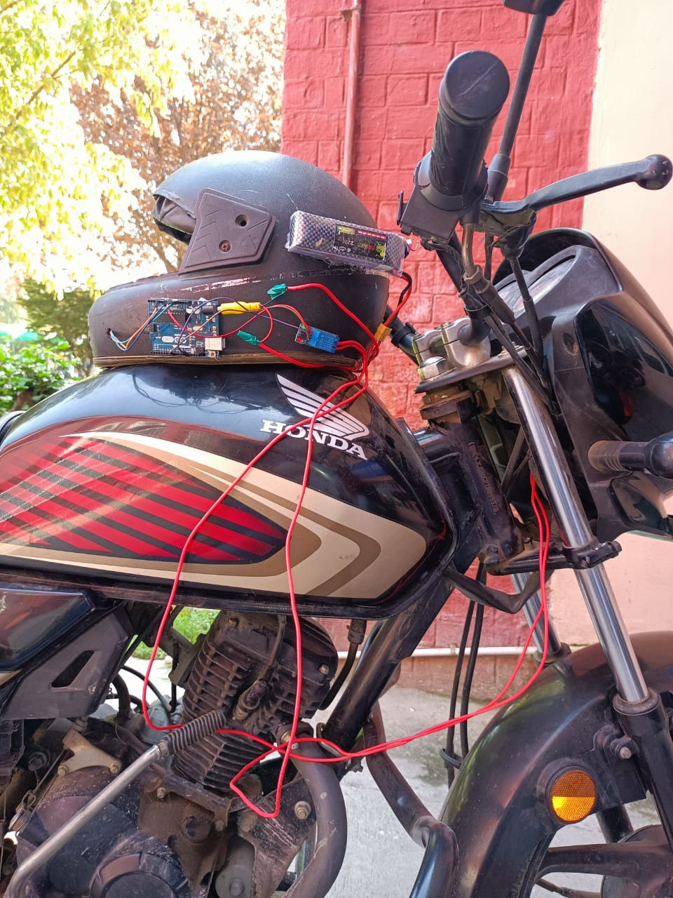

Slide 6
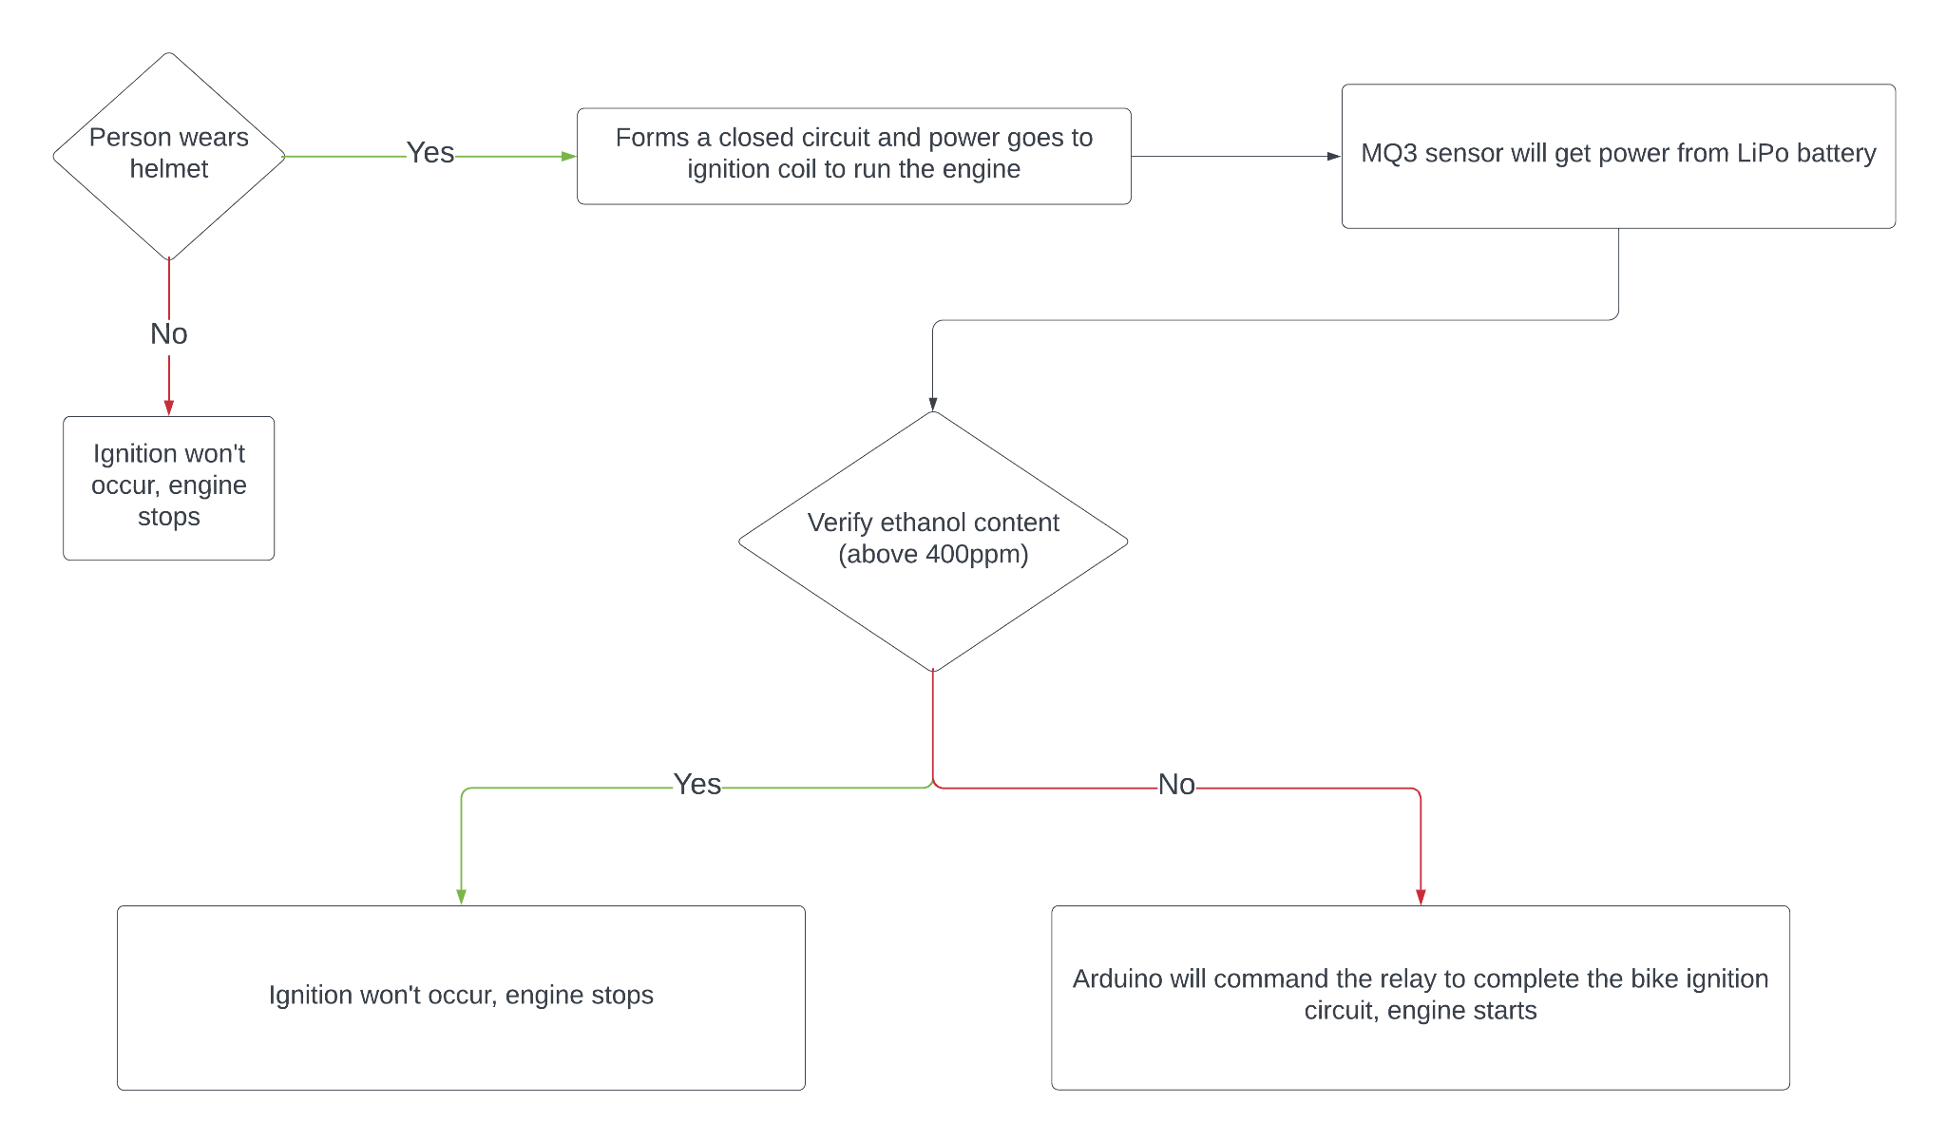
FLOW CHART

Slide 7
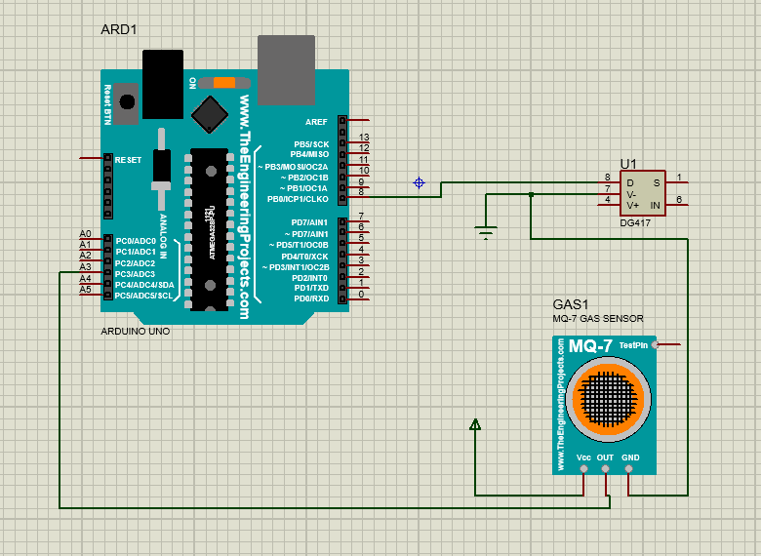

Slide 8
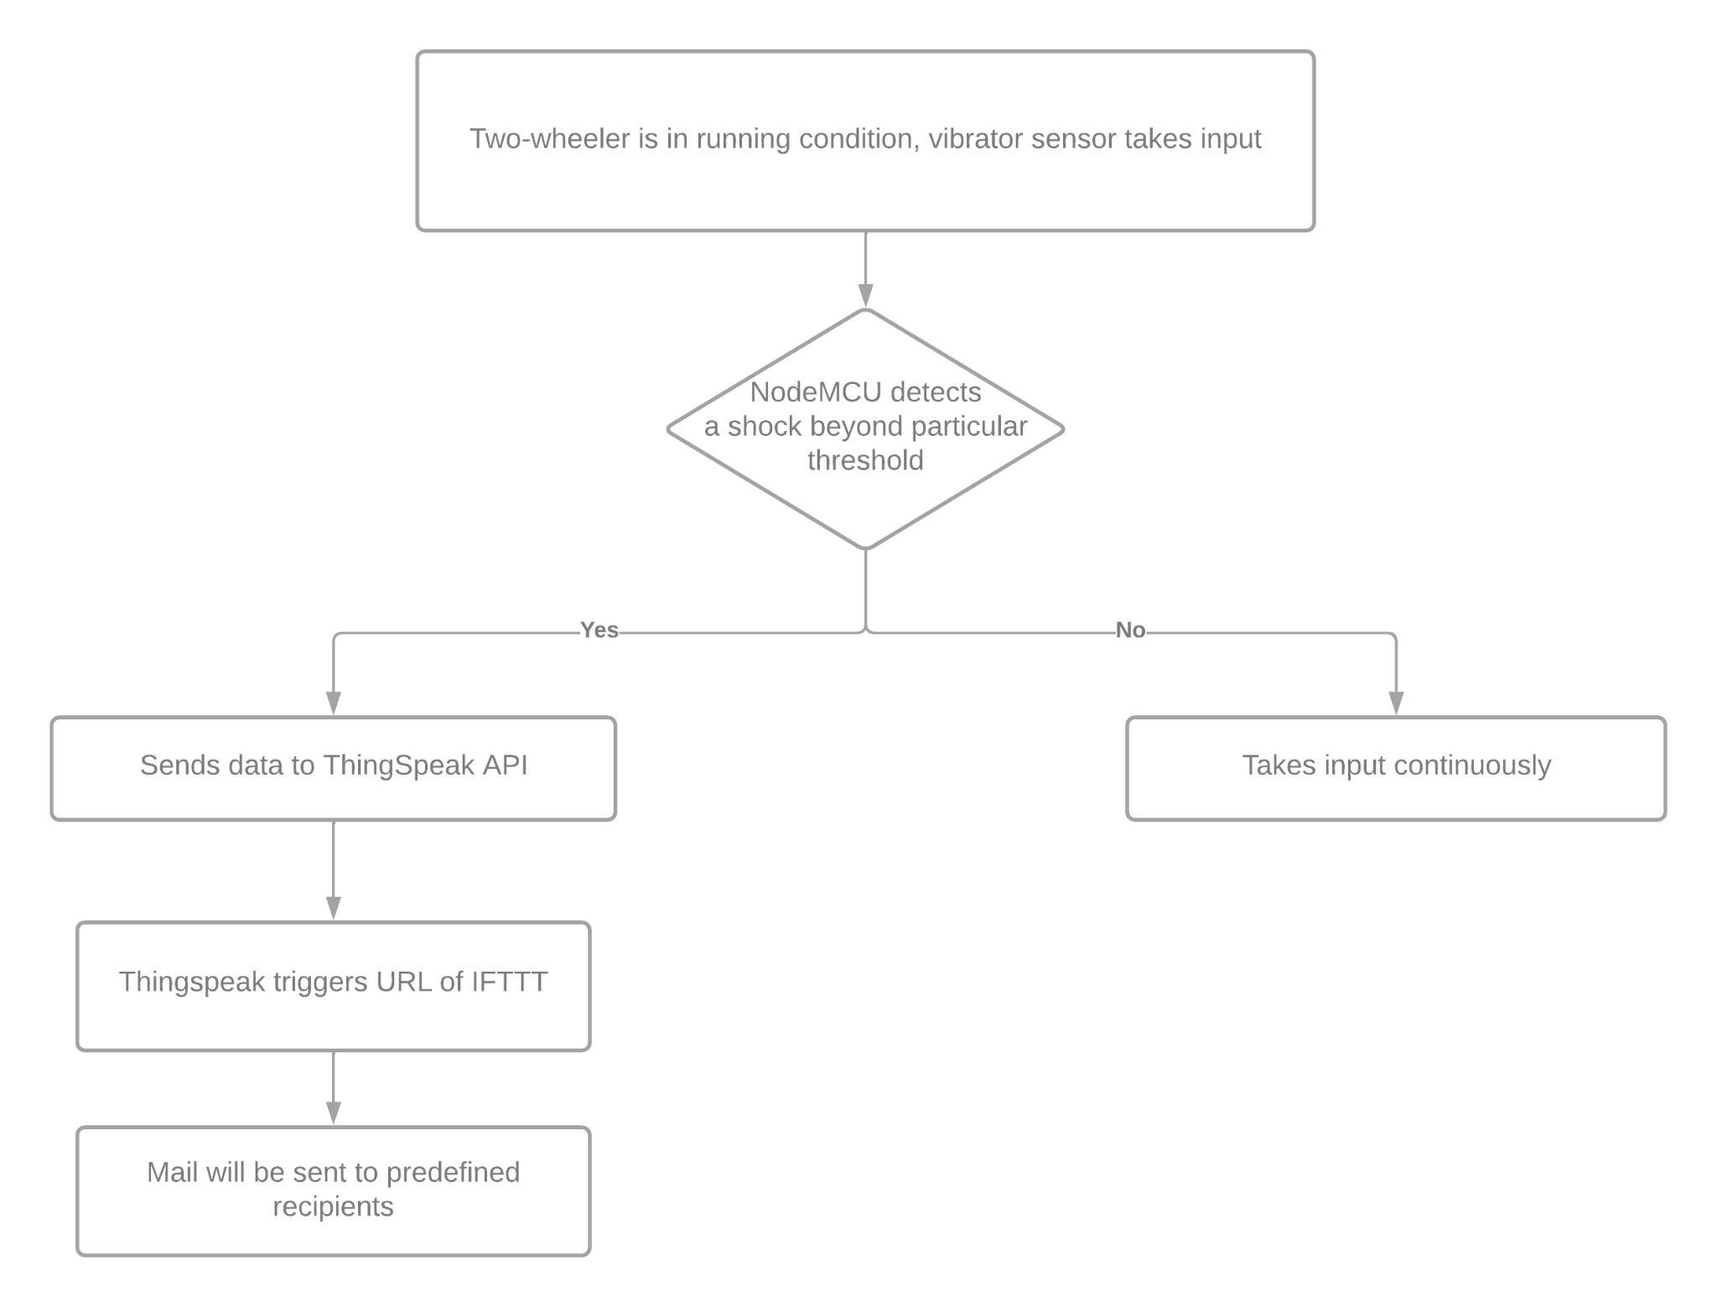
FLOW CHART

Slide 9
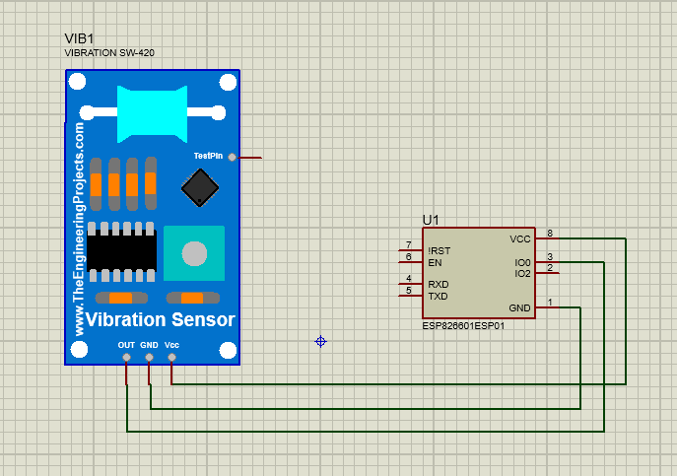

Slide 10
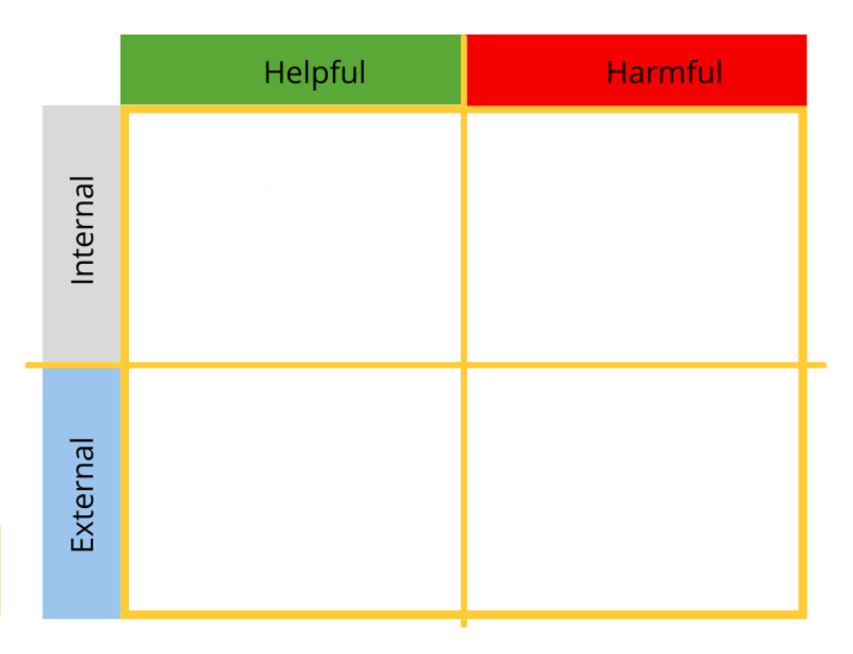
SWOT Analysis
Strengths
Save lives and casualties
Improves accessibility
Weaknesses
Fragile components are used
Opportunities
Can extend our idea to mining, military
Can include other sensors to check dizziness, shock in future
Threats
Competition from conventional helmets that are cheap

Slide 11

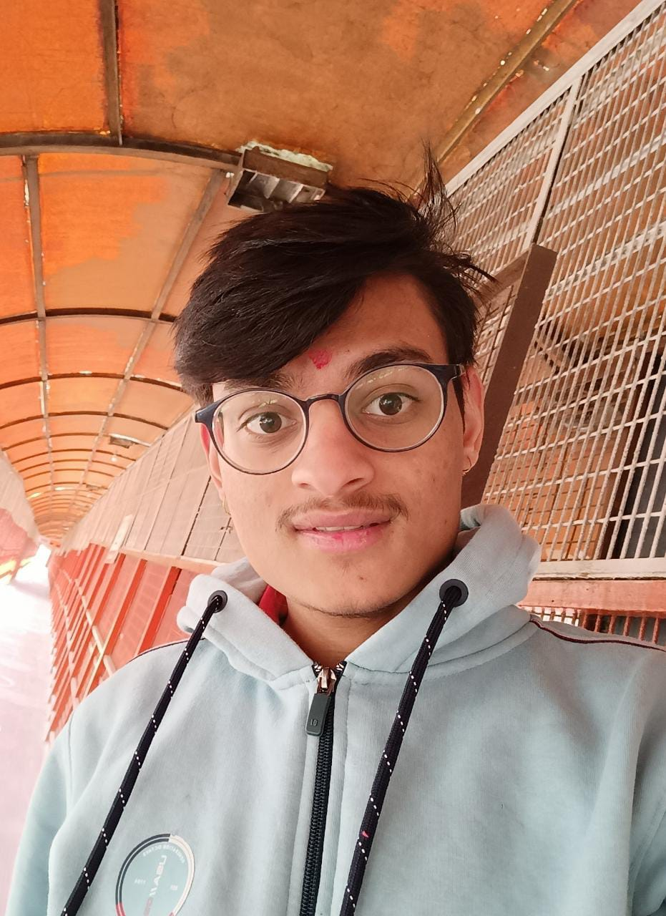




The Innovators
Yash Arora
Gaurav mishra
Akshai kumar
Krishn Iyer
Kasi viswanath
Samiksha saharan

Slide 12
Thank you

